Slide 1

ROAD ACCIDENTS SLOVAKIA
Created by: Michal Uhrinek

Slide 2
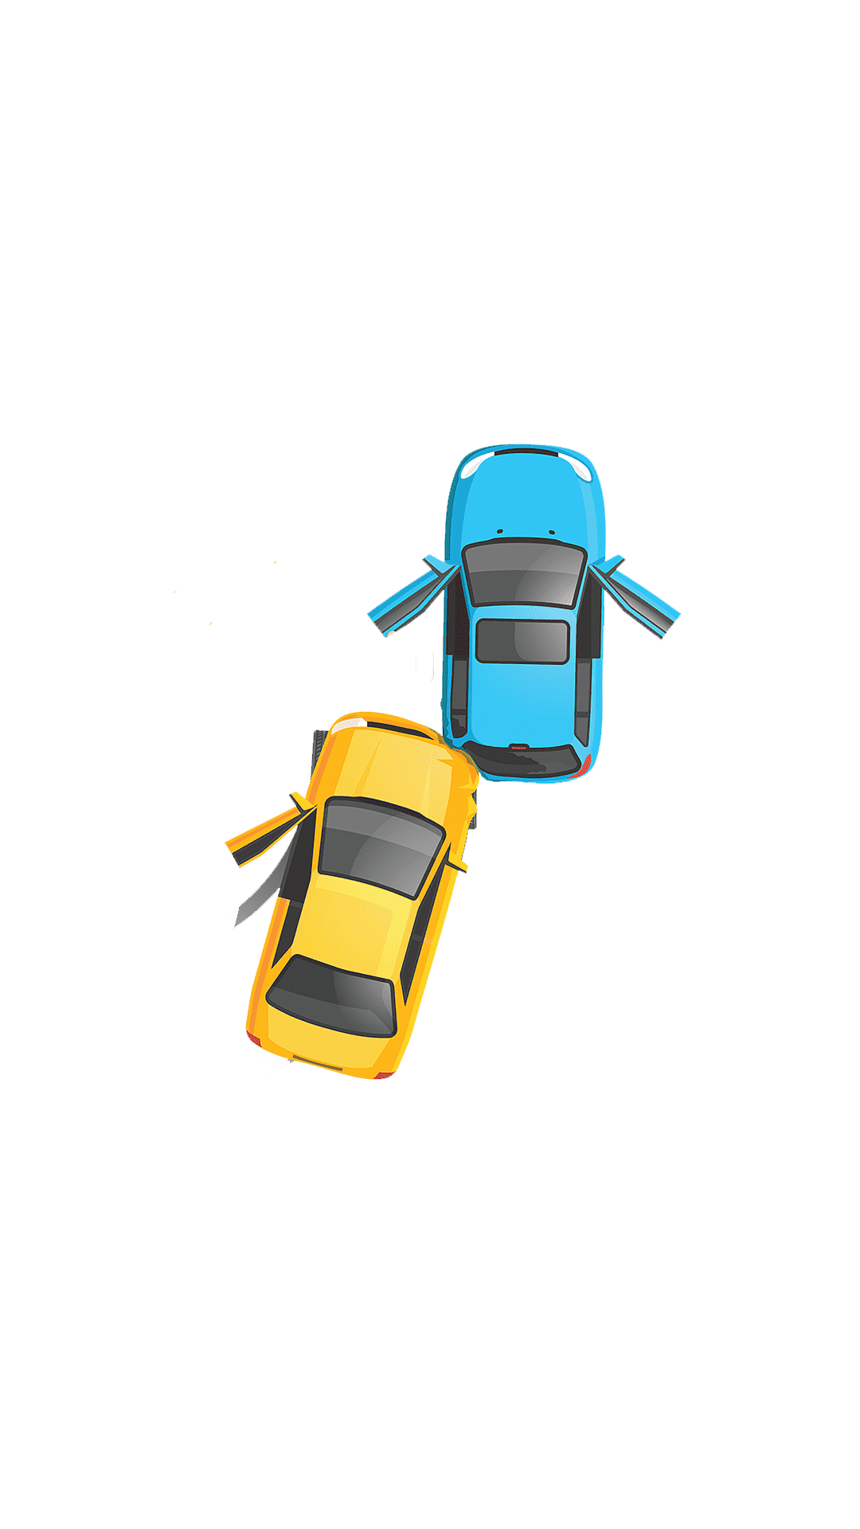
AGENDA
INTRODUCTION
Accidents on Slovak road, cars, bykes, walkers
Almost everyday we hear about accidents on roads. Drunk driver, distracted driving, killed 6people. Lets have a look at the real data and answer why is this happening and how many accidents there are?

Slide 3


Goals
How many accidents are there on roads
in last 10 years?
What are the causes of these accidents?
Is alcohol such a big problem on roads or
its something else?

Slide 4
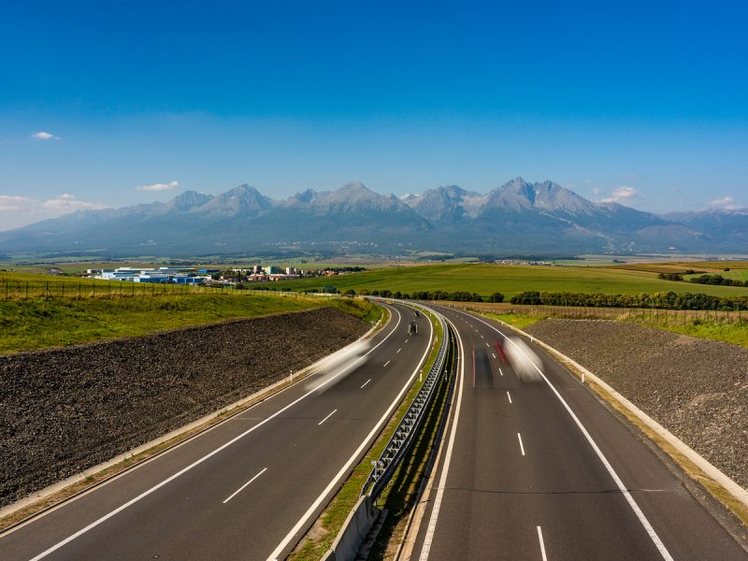
DATA ANALYSIS
Analyzing data to see hidden trends data on Slovak roads which includes: cars, trucks, motocycles, cycles, people crossing road, wild animals and aplying R code demonstrate findings.

Slide 5
Data analysis Process
01
Source of data
02
cleaning, preprocessing data R
Slovak govermnent website:
https://www.minv.sk/?statistika-1&rok=2012&mesiac=12
Using RStudio (getting rid of duplicates, renaming columns, replacing missing values and NAN values with 0)
loading data, analyzing in R
03
04
R visualization using ggplot
Loading file into dataset,
Finding number of deaths, accidents, types of accidents, analyzing relationships between those values.
Using ggplot to visualize data using:
pie chart, bar chart, line chart.

Slide 6

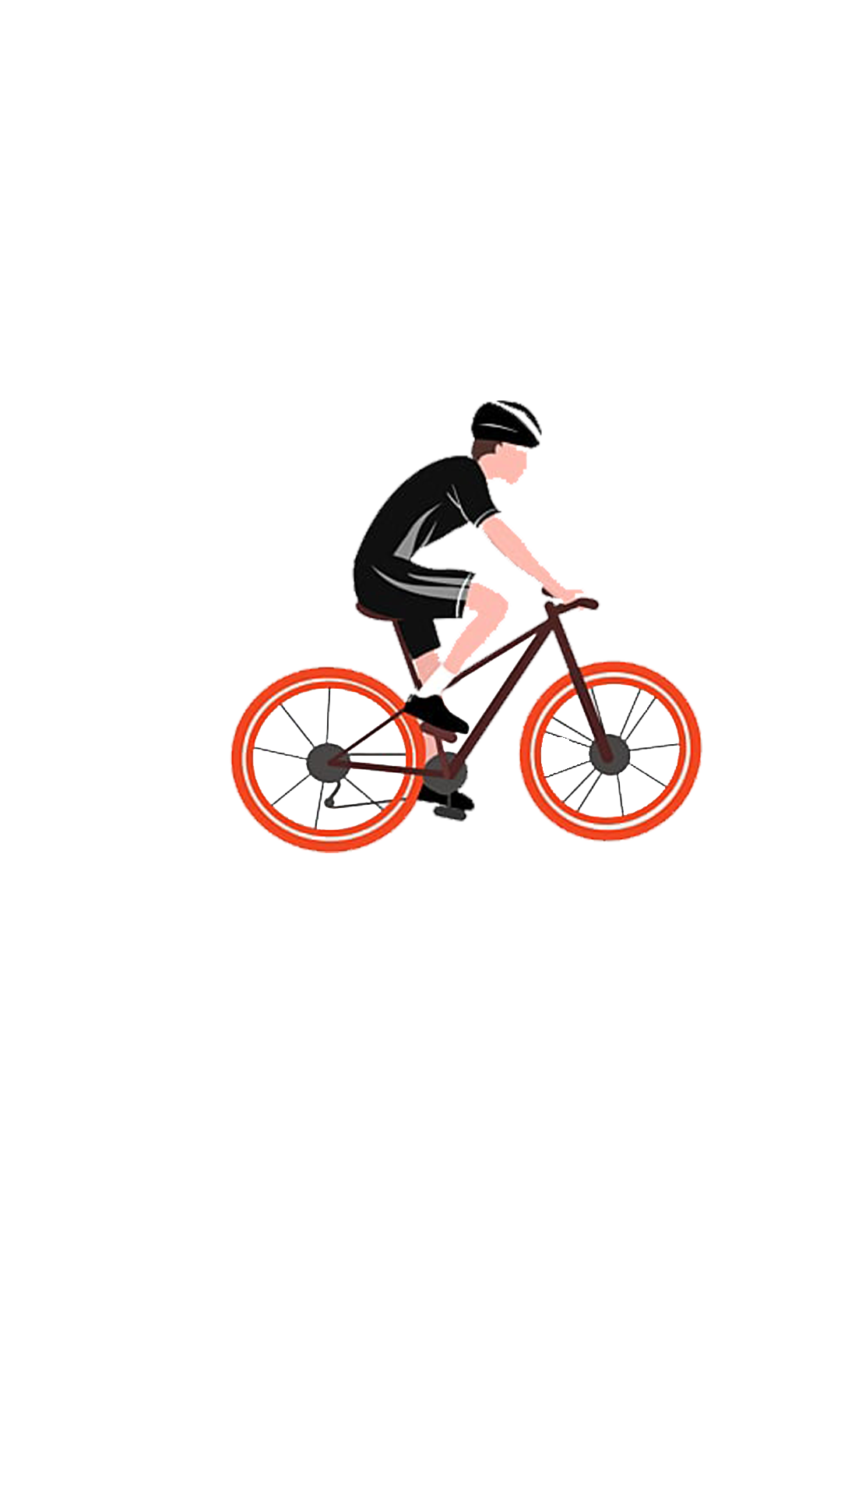
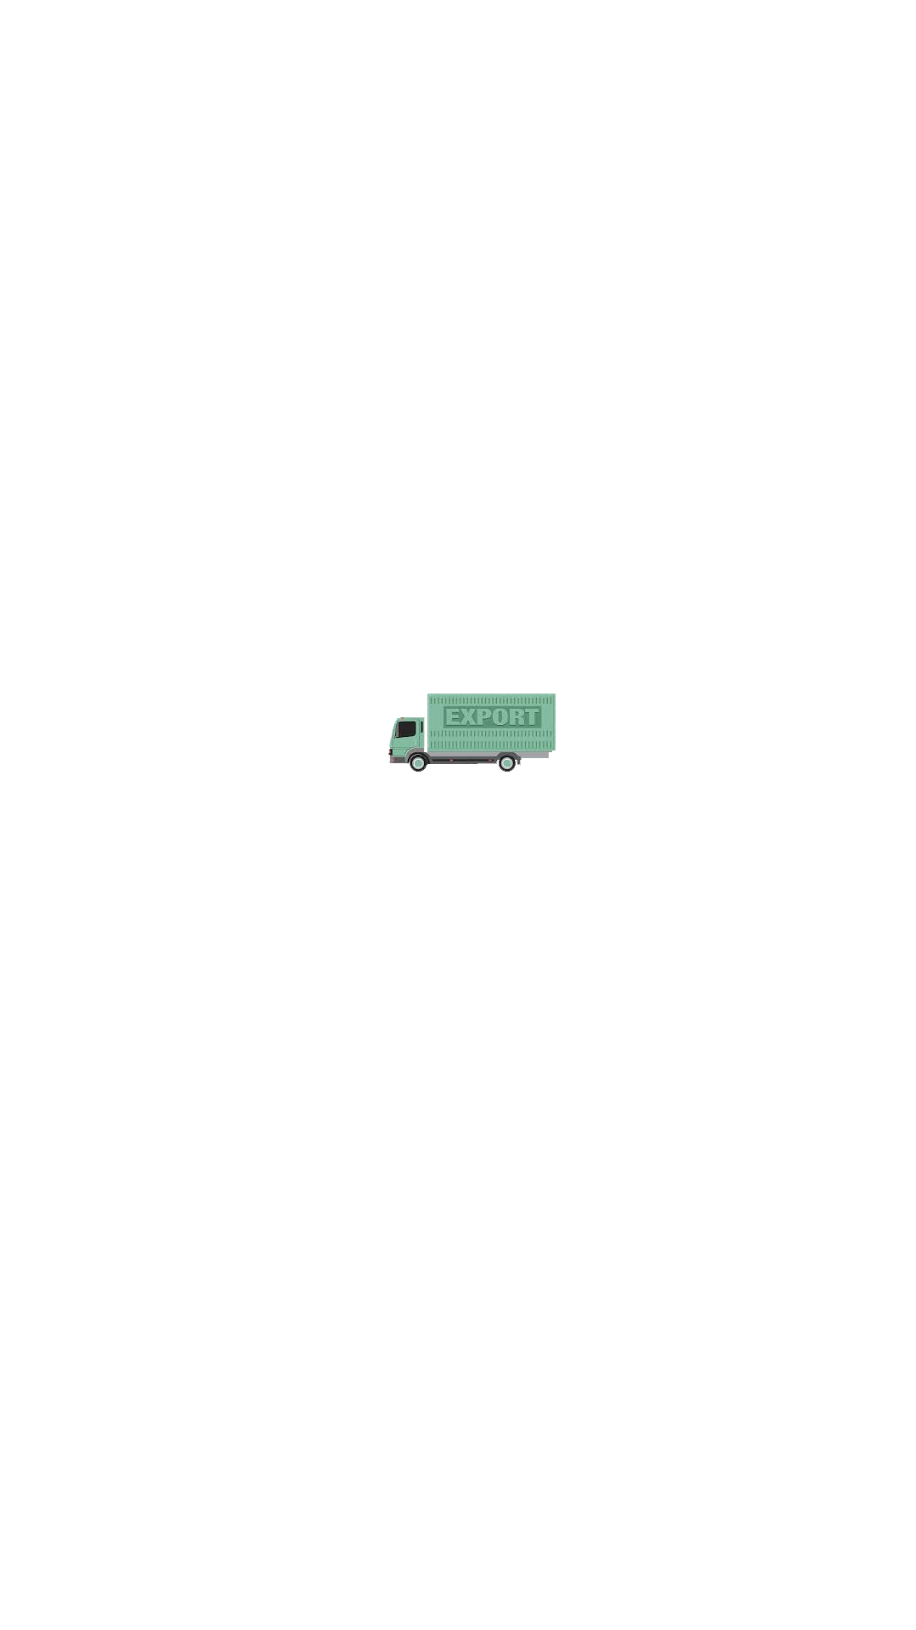
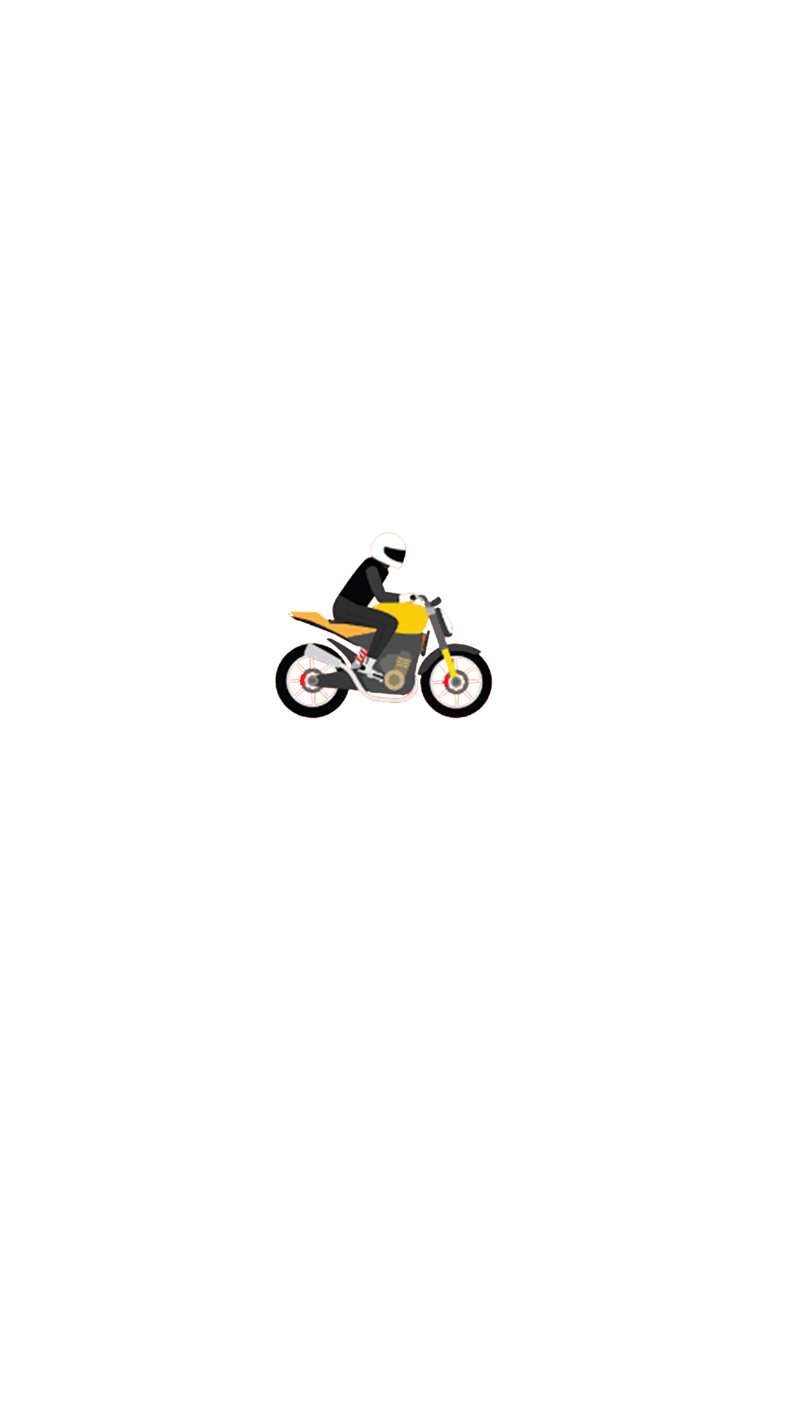
Accident data 2022
1
Car: 6609
2
Cyclist: 457
DEATHS
Total number of all accidents is: 8765
244
People crossing road: 327
3
4
Motocycle: 266
5
Trucks: 135

Slide 7
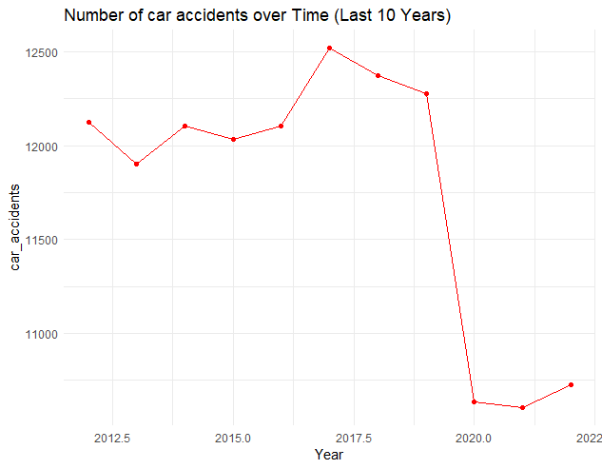
Last 10 years the number of accidents on roads went down by: 33%

Slide 8

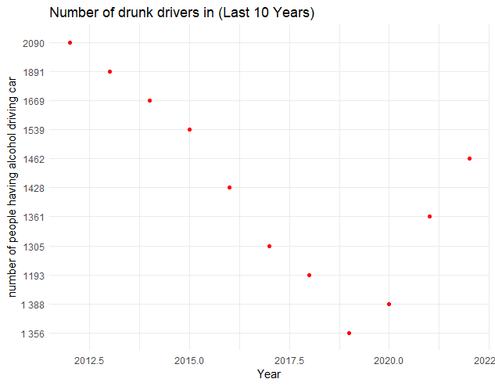
Since 2018 we saw an increase of drunk drivers by: 8%

Slide 9
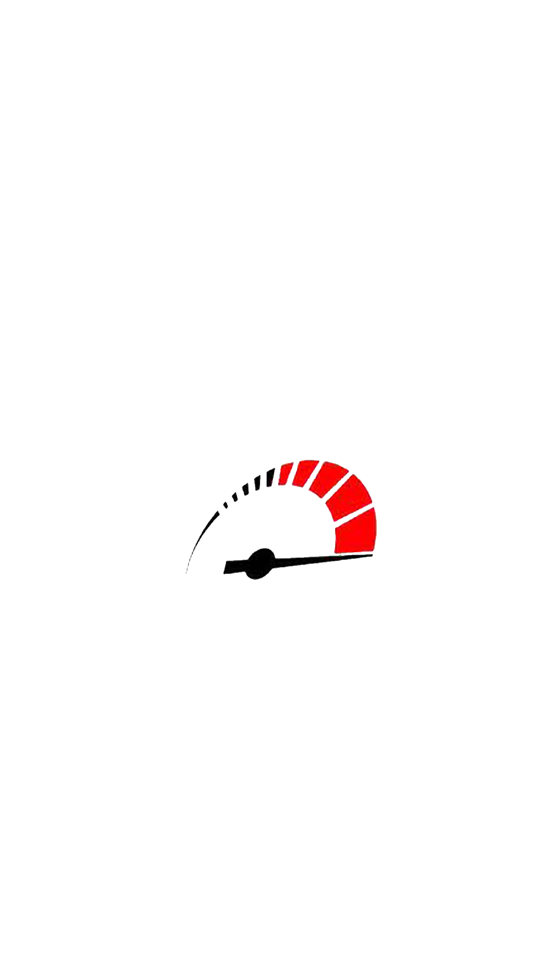
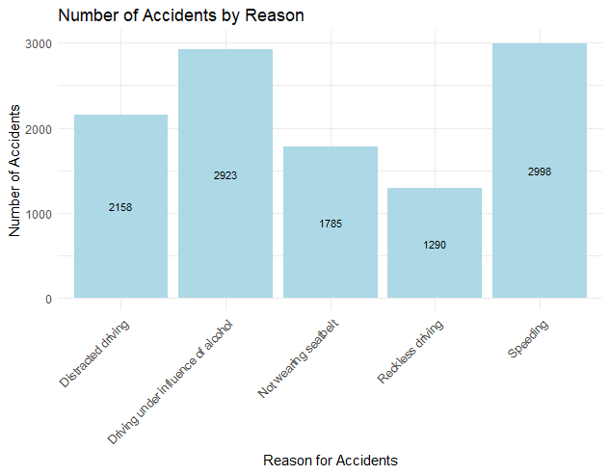
Reason for accidents data
Biggest reason for accident is: speeding!!!

Slide 10
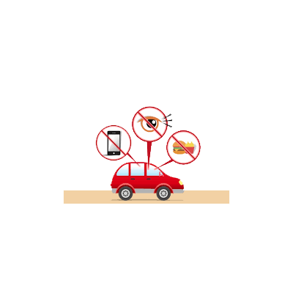
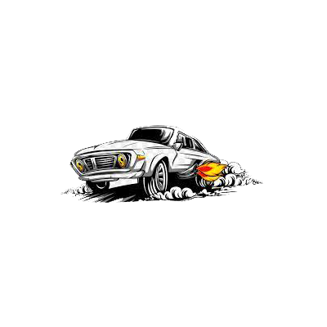
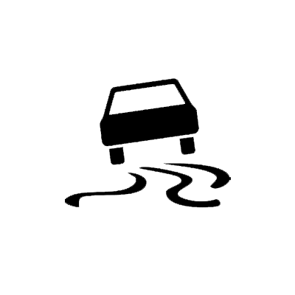

Reason for accidents by %
Distracted driving
Using phone, eating, smoking, not focusing on road.
29.4%
17.9%
Speeding
Breaking speed limits in city and outside otf the city.
CAUSE OF
ACCIDENTS
Driving under influence of alcohol
Having beer, vine, hard liqueurs.
23.2%
Reckles driving
Driving from one side of the road to another side, drifting.
14.8%

Slide 11
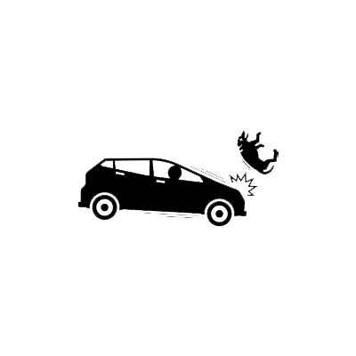
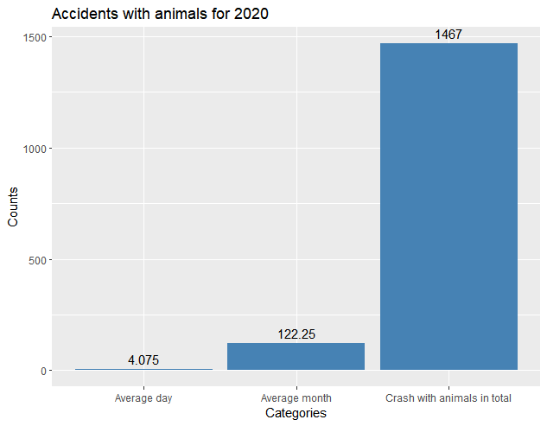
animal crash data
EVERY 6 HOURS THERE WILL BE animal hit by a car.
Distracted driving
CAUSE OF
ACCIDENTS

Slide 12
Alchol & Roads
all the nesseserry data you need to know
All data has been provided by Slovak government

Slide 13

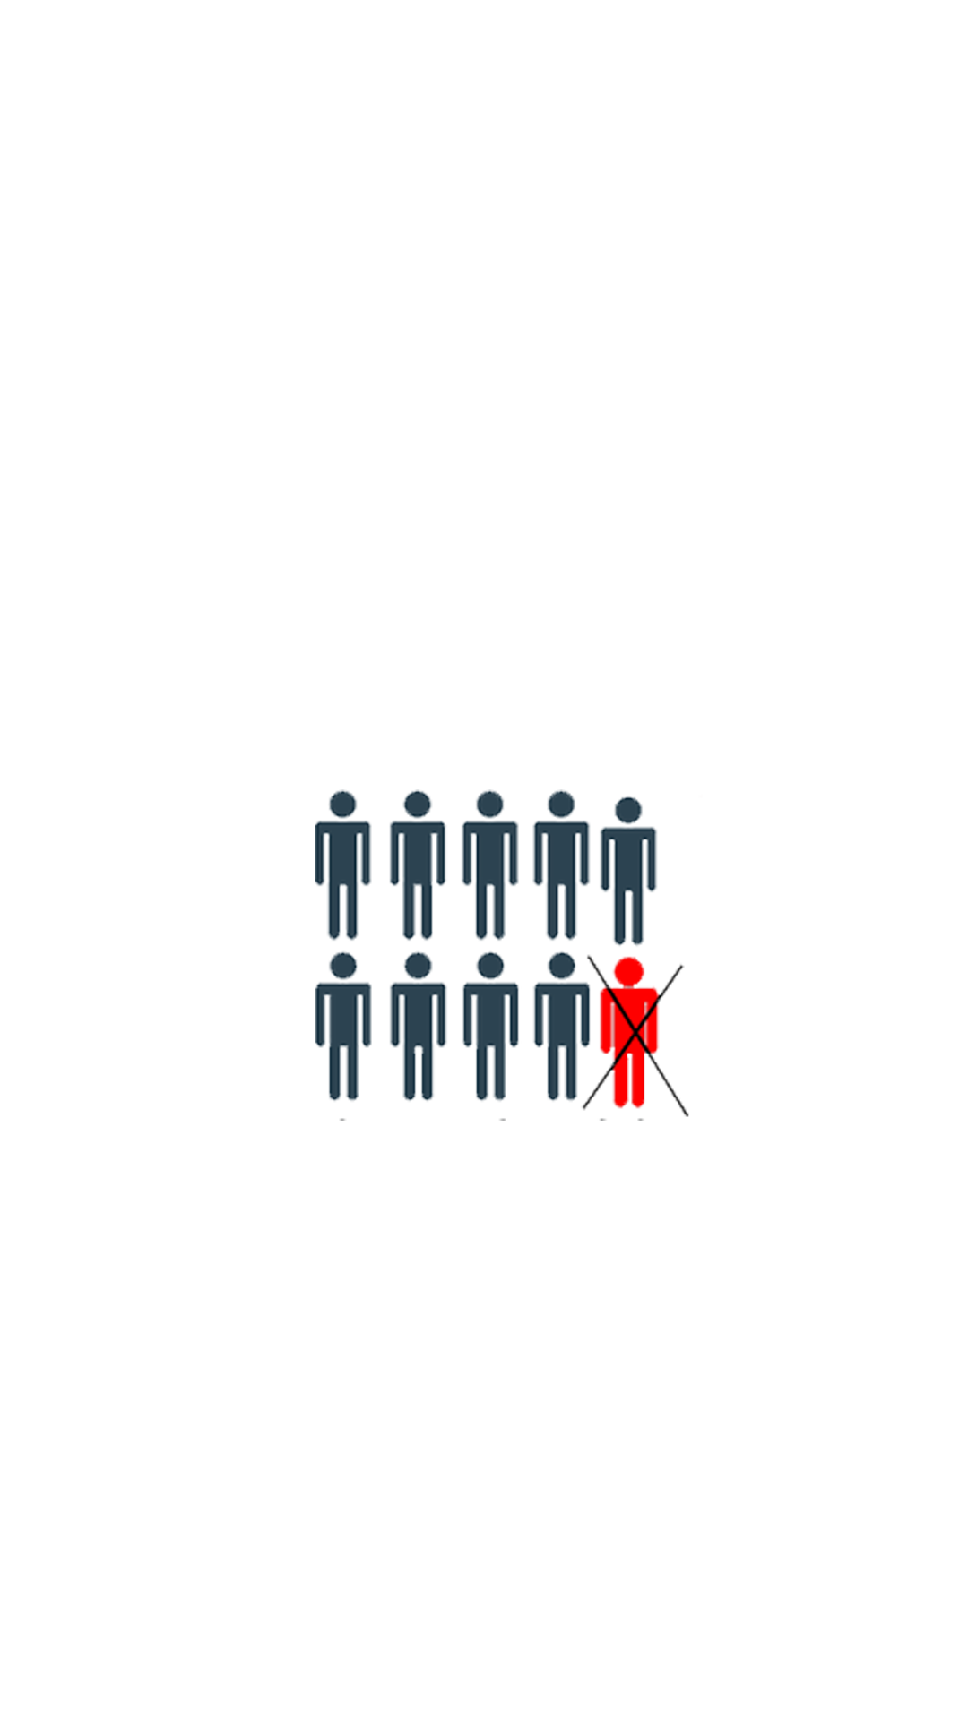

What happens if you drink?
EVERY 6HOURS
1:10
50%
There is an accident involving drunk
driver.
One out of 10 times the driver will die.
Chance that he will kill or hurt someone.

Slide 14

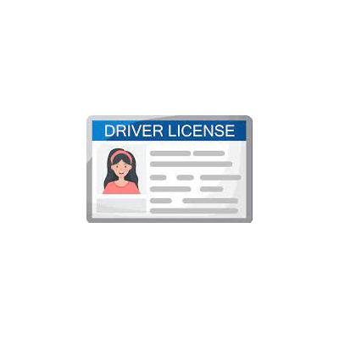

RECOMENDATIONS
CREATE SOCIAL CAMPAIN
AFTER MORE THAN 100mg/l taking the driving licence
Push on law to increase punishment
Using Facebook, Instagram, TikTok, Youtube to crete content to help drivers to be more focused on roads and don’t break speed limits, get drunk, distracted by phones and other divices.
Increase the power of law and put panishment on drivers under influence of alcohol and speeding to get them to work 6 months without wage on cleaning roads and paying 2000 EUR bill.
Immediatelly taking a licence and let person to take it back after a period of 6months. If it happenes again take it permanently.

Slide 15
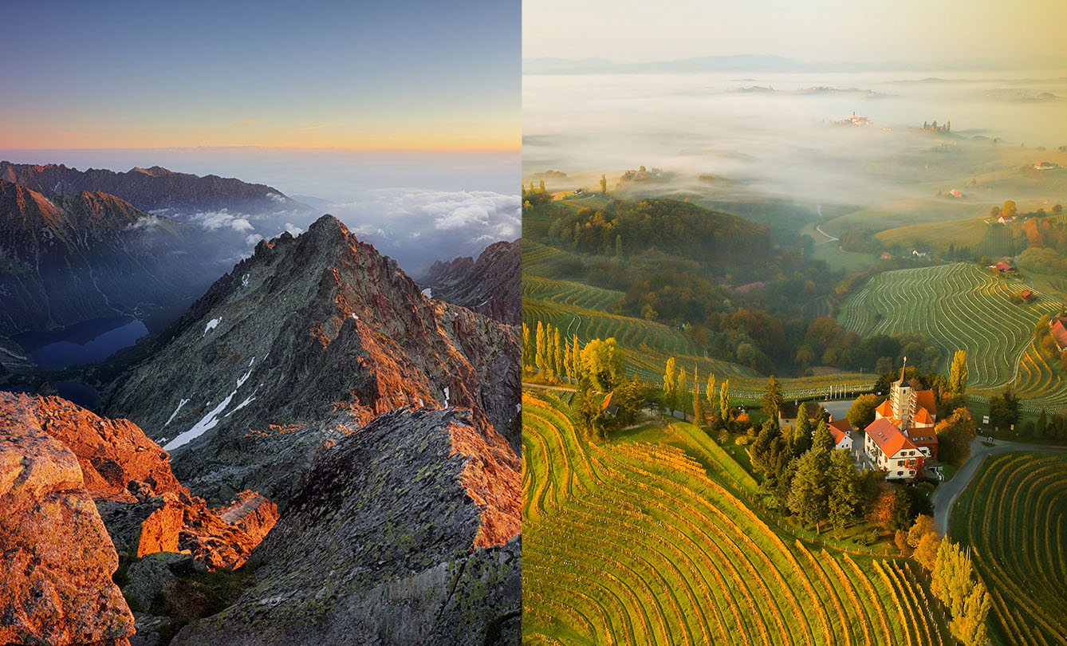
PURPOSE
Almost everyday we hear about drunk drivers or people speeding or reckles driving but if we cut the numbers down, we can have a safer roads and hundreds of people can be saved and thousands does not have to end up in the hospital.

Slide 16
We ca not make others not to drink or drive carefully, but we can help our drunk friend after party
to get home safe. Do not use phone, stay focused on road. Remember it all starts with ourselves.

Slide 17
THANKS

Slide 18

Apendix
Resources:
Languages used/tools:
SQL( Microsoft SQL Management Studio), R (RStudio), Adobe Photoshop
LInk to Github: https://github.com/michaluhrinek/Data-Analyst---Portfolio-SQL-EXCEL-PYTHON-/tree/main/Google%20Data%20Analytics/Slovak%20Roads%20Accidents
Data were provided by Slovak governmend, police partment: https://www.minv.sk/?statistika-1&rok=2012&mesiac=12
Data were collected and edited in SQL using SQL Management Studio. Sorted in RStudio using R language and using ggplot visualizations were created. Using Adobe Photoshop(picture editing).

